Slide 1
End-to-End ML Pipeline for Customer Churn Prediction
Building a Fully Automated Solution
By Rishabh Sipani, Sujal Sinha & Niladri Sarkar

Slide 2
Introduction
This presentation outlines the development of a machine learning pipeline designed to predict customer churn based on historical behavior and account data. The project utilizes various technologies and methods to ensure efficiency and reliability.

Slide 3
Table of Contents
Problem Definition
Pipeline Architecture
Data Pre-processing
Model Training (MLFlow)
Model Serving with Flask
Postman Testing
Dockerization
Workflow Automation with Git & DVC
Conclusion

Slide 4

Problem Definition
What is Customer Churn? Customer churn occurs when a customer stops using a company's service.
Goal: Predict which customers are likely to churn so businesses can retain them proactively.
Dataset: customers_clean.csv includes features like age, tenure, services used, contract type, monthly charges, etc.

Slide 5

Pipeline Architecture
Data Ingestion: Loading and versioning input data using DVC.
Preprocessing: Handling missing values, encoding categorical variables, and scaling features if necessary.
Model Training: Training Random Forest and Logistic Regression models.

Slide 6
Model Selection: Automatically select best model ('champion’) from MLFlow monitoring.
Model Serving: Serving champion model with Flask REST API.
Testing: Using Postman or cURL to test endpoint.
Containerization: Packaging everything in Docker, making it portable.

Slide 7
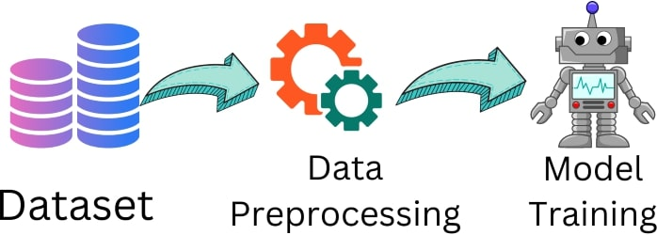
Data Preprocessing
File: preprocess.py
1. Fill missing values using forward fill.
2. Label encode categorical features.
3. Scale numeric features.
4. Split into train/test.
5. Save scaler and dataset splits with joblib.
6. Track files using DVC.

Slide 8
Model Training
File: train.py
1. Trains Random Forest & Logistic Regression.
2. Uses accuracy_score to evaluate. 3. Logs runs with MLflow (params, metrics, model).
4. Selects the best performing model ('champion’).
5. Saves it as model/churn_model.pkl.

Slide 9
Model Serving with Flask
File: app.py
1. Loads the saved scaler and champion model.
2. Defines /predict route that accepts JSON.
3. Scales input and returns prediction (0 or 1).
4. Can be tested via Postman or any HTTP client.

Slide 10
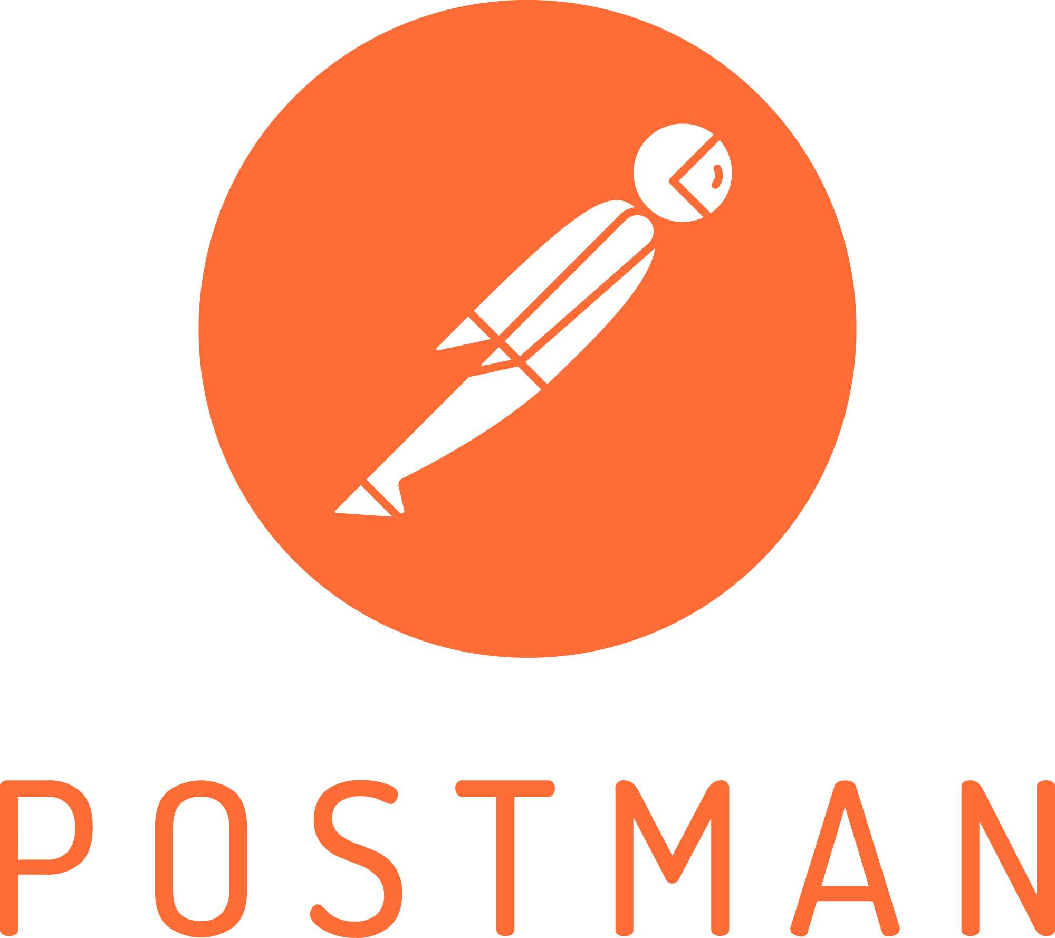
Postman Testing
URL used: http://localhost:5000/predict
Headers: Content-Type: application/json
We just need to make sure the input is sent in raw JSON format
Example: JSON Body= { "features": [34, 1, 5, 0, 1, 0, 1, 0, 1, 1, 1, 1, 0, 1, 1, 2, 70.35, 1397.5, 0] }
Expected response from model: { "churn": 1 }

Slide 11
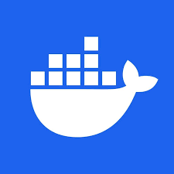
Dockerization
Dockerfile includes:
Python 3.11 base image, Project files and dependencies, Runs app.py automatically on container start.
Commands:
docker build -t churn-api . docker run -p 5000:5000 churn-api.
Result:
Fully portable app, runnable on any Docker-enabled system.

Slide 12
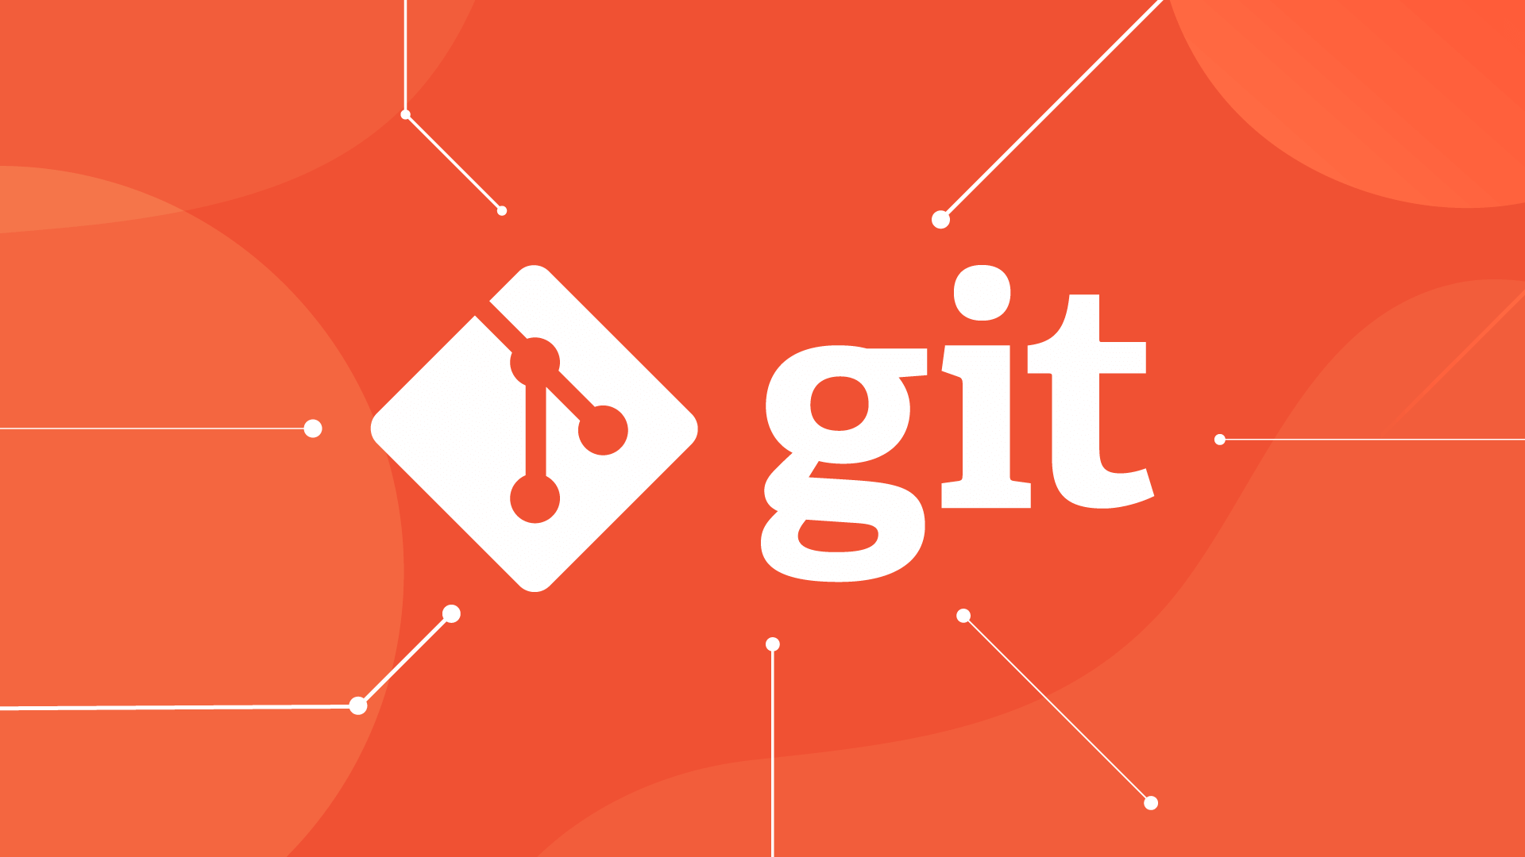
Workflow Automation with Git & DVC
Version control with Git. Data and model tracking with DVC. All pipeline components (data, models, scripts) are reproducible. Push to GitHub and DVC remote for ease of access.

Slide 13
Conclusion
Successfully built an end-to-end churn prediction pipeline. Incorporated reproducibility, experiment tracking, API deployment, and containerization. Project is portable, testable, and production-ready. Future Work: Add monitoring for API usage, Deploy to a cloud platform (e.g., Render, Railway, Hugging Face Spaces), Automate with CI/CD pipelines (GitHub Actions, Jenkins, etc.).

Slide 14
THANK YOU!

